Slide 1
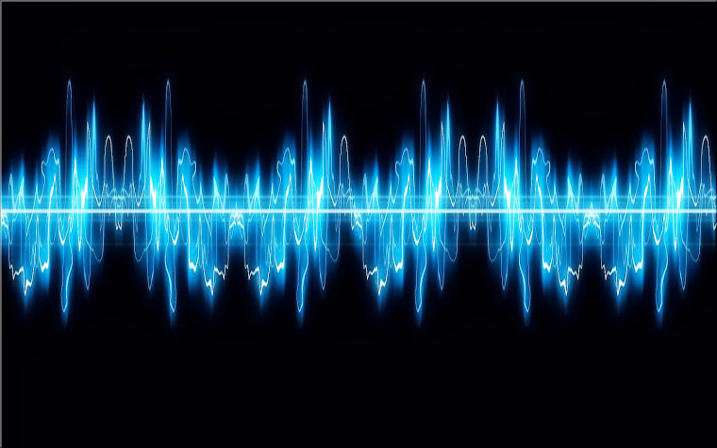
Pattern Recognition
Project title: Speech Recognition
Presented by :
Mohamed Abdelfattah Younes
Mohamed Khaled Abdelmonem
Abdelrahman Mostafa Anwar
Mohamed Ibrahim Mohamed
Mohamed Yousef Mohamed
Mahmoud Ayman Ahmed
Supervised by: Dr/: Hafez Abd El Wahab

Slide 2
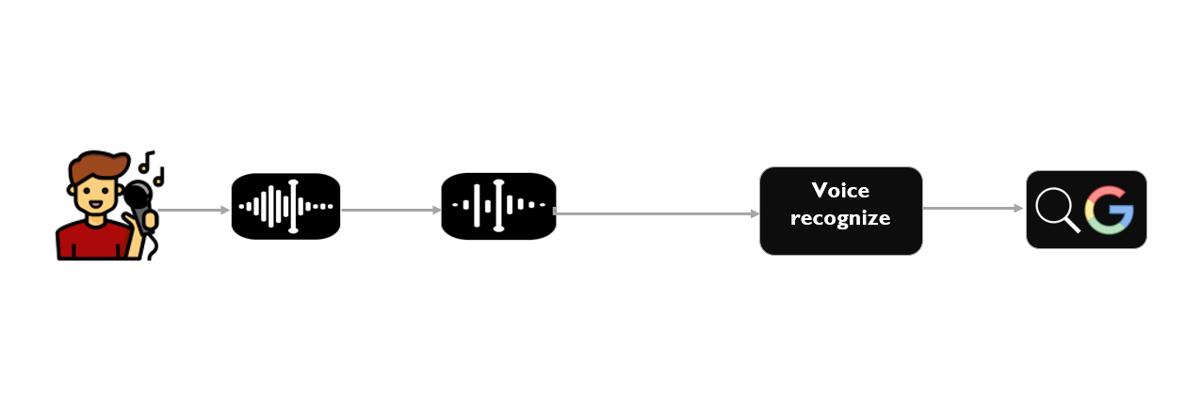
Block Diagram

Slide 3
Hidden Markov Model (HMM)
A Hidden Markov Model (HMM) is a statistical and probabilistic model which is also used in machine learning. It can be used to describe the evolution of observable events that depend on internal factors, which are not directly observable.

Slide 4
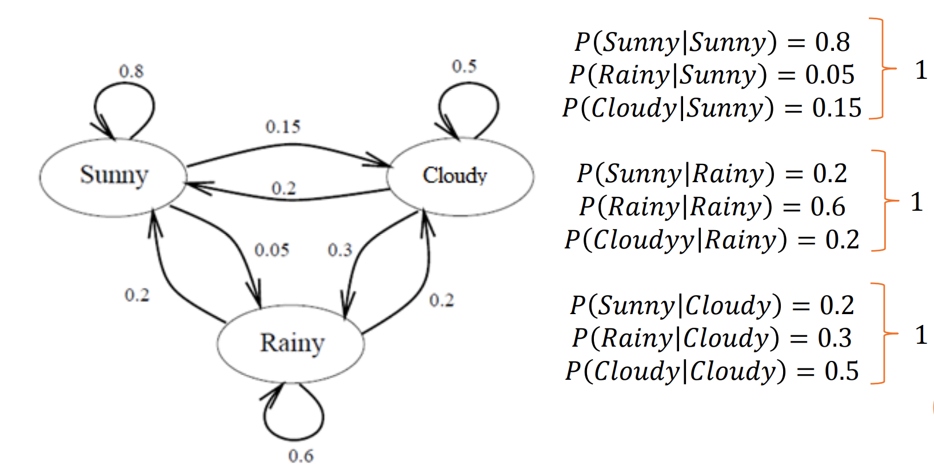
Example

Slide 5
Layers of Hidden Markov Model (HMM)
In the First Layer when I say any letter the model check that the letter is the right letter i said, the probability of the right letter is the higher one.
In the Second Layer we will be filtering the first layer to knowing what you said
In the Third Layer the model knowing the right based on the spectrogram.

Slide 6
Recognizer Class
The SpeechRecognition library has several libraries, but we will only be focusing on the Recognizer class. The Recognizer class will help us to convert the audio data into text files.

Slide 7
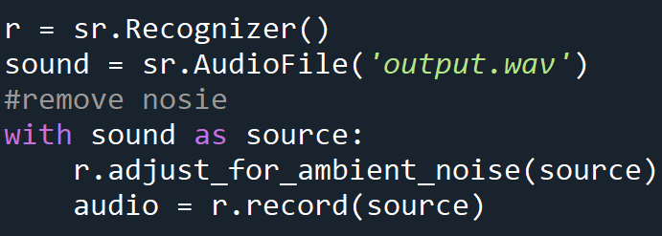

Handling Noise
Adjusts the energy threshold dynamically using audio from source (an AudioSource instance) to account for ambient noise
Should be used on periods of audio without speech - will stop early if any speech is detected.
The duration parameter is the maximum number of seconds that it will dynamically adjust the threshold for before returning. This value should be at least 0.5 in order to get a representative sample of the ambient noise.

Slide 8
recognize_google() (Voice Recognizer)
we'll use the recognize_google() method on it to access the Google web speech API and turn spoken language into text.
recognize_google() requires an argument audio_data otherwise it will return an error.
US English is the default language. If your speech or audio file isn't in US English, you can change the language with the language argument. A list of language codes can be seen here.

Slide 9

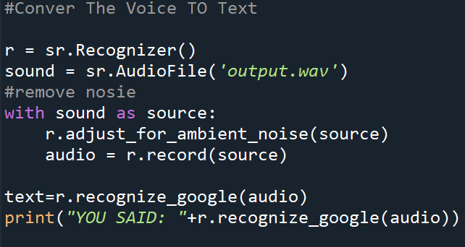
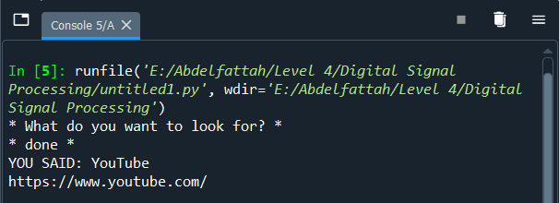
Voice recognizer
Output

Slide 10
Audio Preprocessing
While passing the audio data if you get an error it is due to the wrong data type format for the audio file. To avoid this kind of situation preprocessing of audio data is a must there is a class especially for preprocessing the audio file which is called AudioFile.

Slide 11
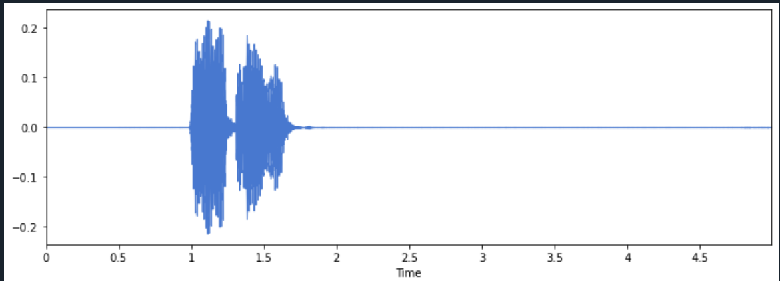
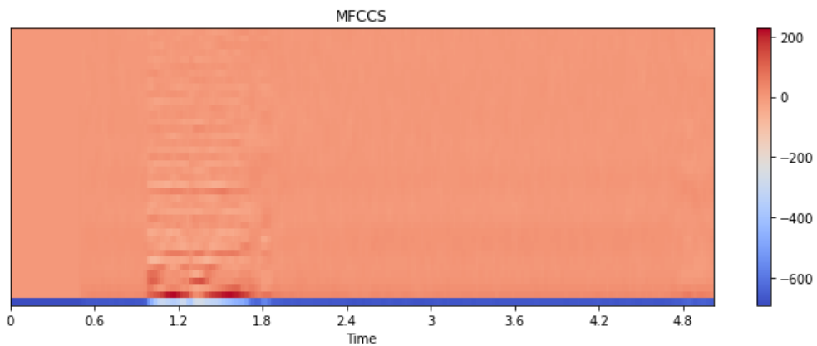
ORIGNAL SIGNAL

Slide 12
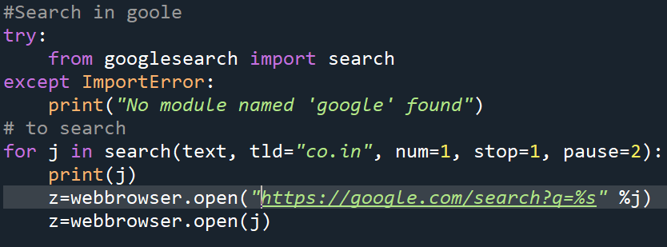
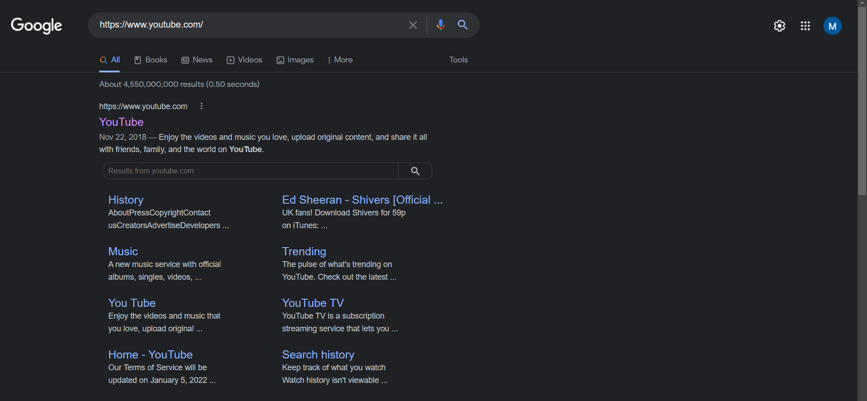
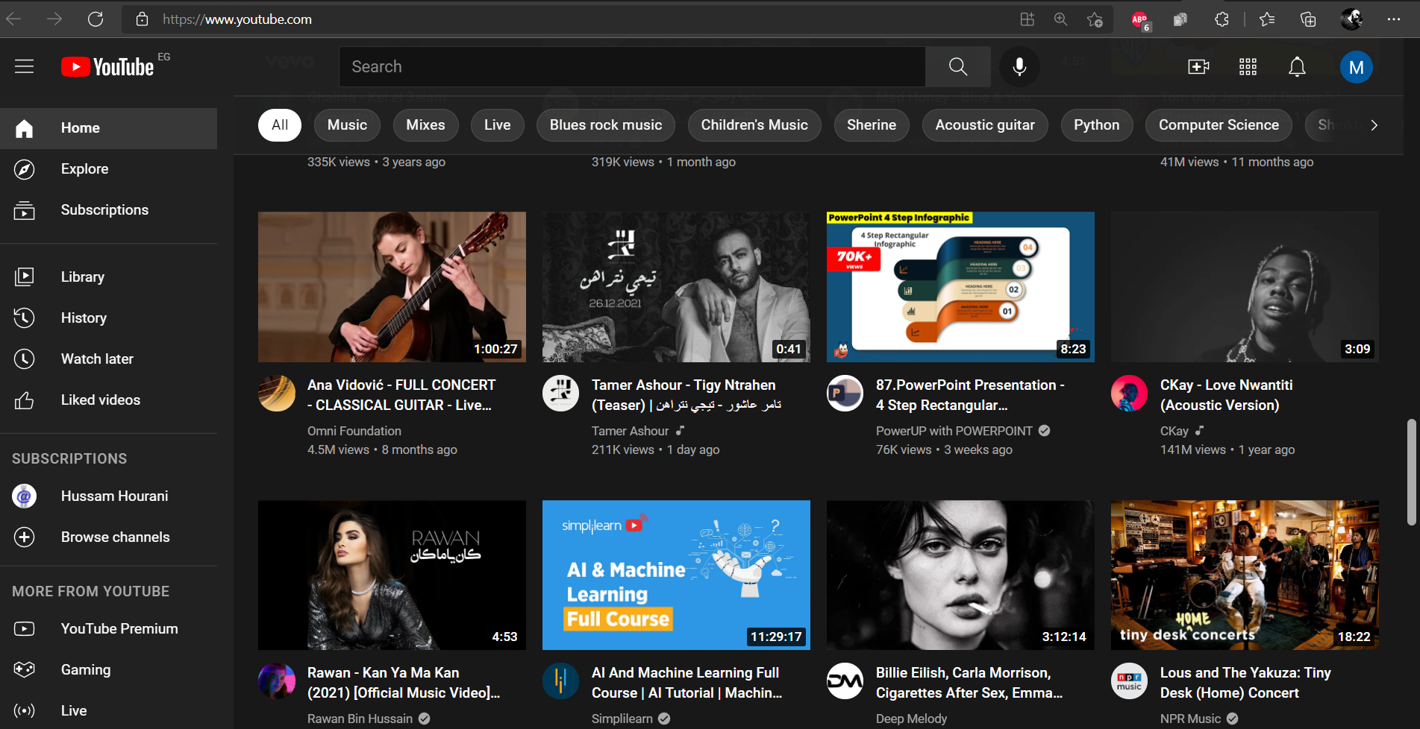
Search in Browser

